Slide 1
Employee Attrition Analysis and Prediction
Naveenkumar Sivakumar

Slide 2
WHY IS EMPLOYEE ATTRITION IMPORTANT?
High Costs: Replacing a worker costs significantly more than keeping one.
Lost Knowledge: Critical "know-how" and skills walk out the door.
Lower Productivity: Teams slow down while waiting for and training new hires.
Team Burnout: Remaining staff get overworked, leading to lower morale.
Damaged Reputation: High turnover makes it harder to hire great people.
Customer Impact: Inconsistent service leads to unhappy clients.

Slide 3
Project Overview: Addressing Employee Attrition
The Problem: High turnover increases costs and disrupts team productivity.
The Goal: Identify why employees leave and predict who might be at risk.
The Method: Analyze workforce data to find the "key drivers" of attrition.
The Outcome: Build predictive models to help management take action before people quit.
The Value: Shift from reactive hiring to proactive employee retention.

Slide 4
Pillar 1: Identify At-Risk Employees
📍 Recognition & Engagement Gaps
Monitor engagement scores and recognition programs
📈 Performance Trends
Track performance changes and career progression signals
💬 Exit Interviews & Feedback
Implement targeted strategies and interventions

Slide 5
Pillar 2: Cost Optimization
🎓 Reduce Recruitment Costs
Improve time-to-hire through internal mobility and succession planning
📚 Streamline Onboarding
Accelerate productivity with structured training programs
💡 Minimize Attrition Impact
Retain top performers through career development and benefits

Slide 6
Pillar 3: Workforce Planning
🔮 Predictive Analytics
Use data-driven insights to forecast turnover and skill gaps
🎯 Strategic Alignment
Align retention strategies with business goals and growth plans
😊 Employee Satisfaction
Improve engagement through career development and culture

Slide 7
ML Workflow: End-to-End Pipeline

Slide 8
Phase 1: Data Collection & Preprocessing
📊 Data Sources
HR systems, payroll, performance records, employee demographics
🧹 Data Cleaning
Handle missing values, remove duplicates, fix outliers and inconsistencies
⚖️ Data Preprocessing
Normalize numerical data, encode categorical variables, balance classes

Slide 9
Phase 2: Exploratory Data Analysis (EDA)
🔍 Pattern Discovery
Identify attrition trends, distribution analysis, statistical summaries
📈 Correlation Analysis
Analyze relationships between features and attrition, identify key drivers
📊 Visualization
Create heatmaps, histograms, scatter plots to understand data patterns

Slide 10
Phase 3: Feature Engineering
🏷️ Feature Creation
Tenure categories, engagement scores, work-life balance metrics
🔧 Feature Transformation
Scaling, normalization, log transformations, polynomial features
⭐ Feature Selection
Select most relevant features using correlation and importance analysis

Slide 11
Phase 4: Model Building & Evaluation
🤖 Model Development
Logistic Regression, Decision Trees, Random Forests, Gradient Boosting
📊 Model Evaluation
Accuracy, Precision, Recall, F1-Score, ROC-AUC, Confusion Matrix
⚡ Hyperparameter Tuning
Optimize model performance using cross-validation and grid search

Slide 12
Phase 5: Actionable Insights & Visualization
📱 Streamlit Dashboard
Interactive visualizations for attrition trends, at-risk employees, department analysis
💡 Business Insights
Identify high-risk employee segments and actionable retention strategies
📋 HR Recommendations
Targeted interventions, career development, compensation adjustments

Slide 13
Streamlit Dashboard Components
Attrition Rate by Department - Filter and compare attrition across teams
Risk Prediction Widget - Enter employee details to get attrition probability
Salary vs Satisfaction Analysis - Visualize compensation impact on retention
Tenure Trends - Analyze retention by experience level

Slide 14
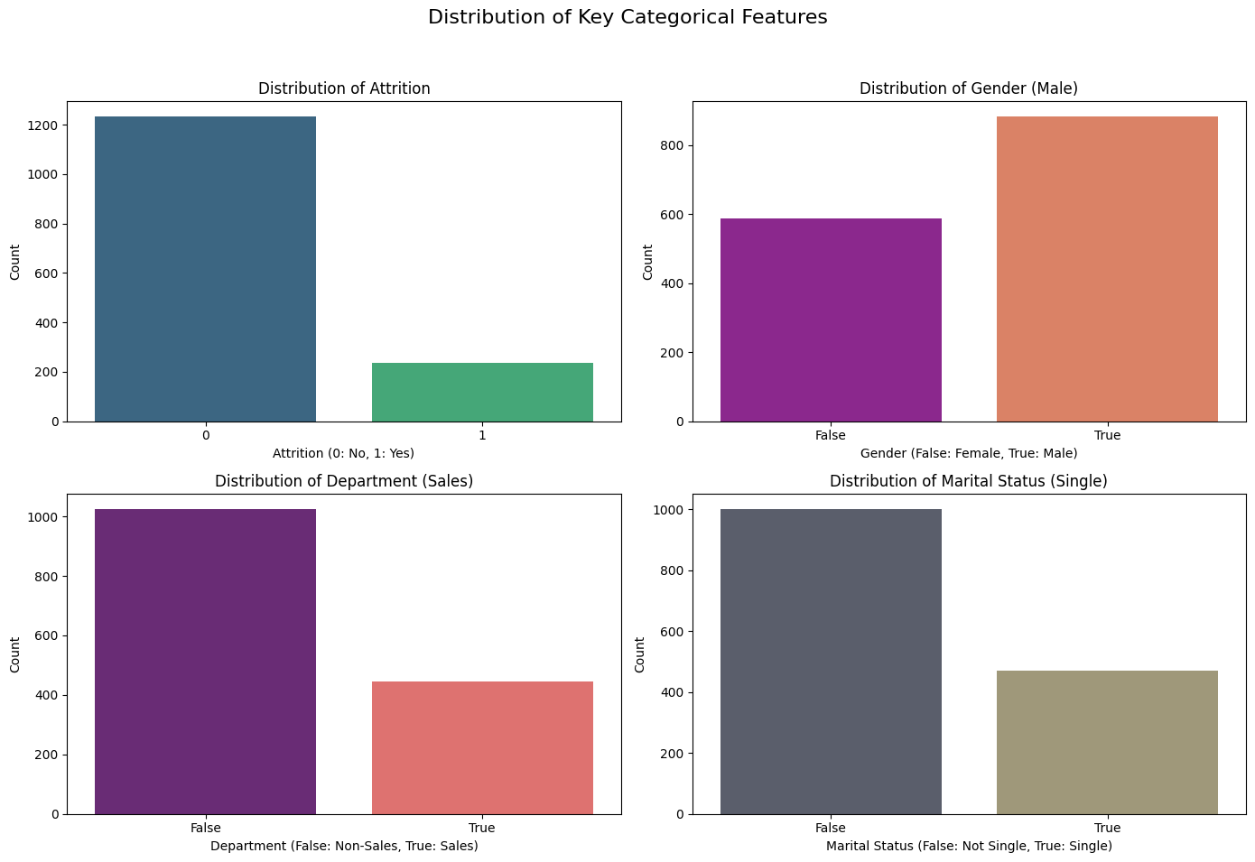

Slide 15
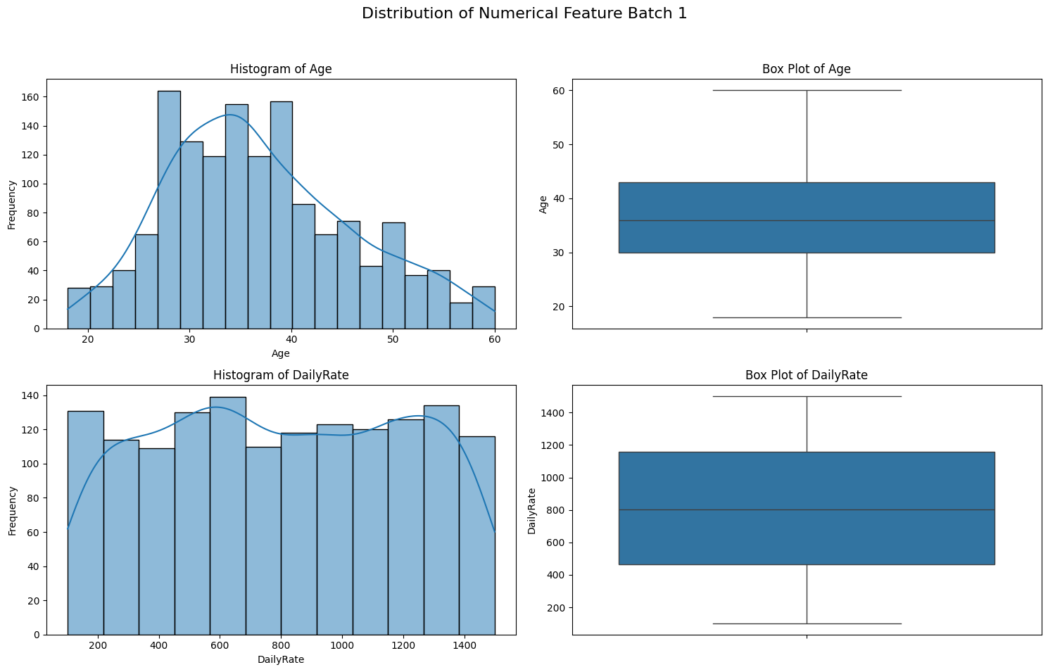

Slide 16
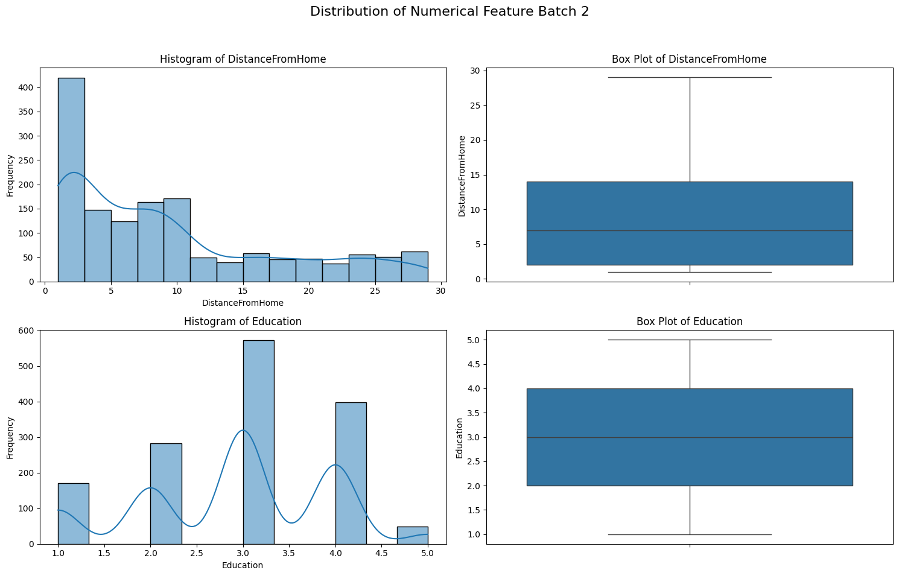

Slide 17
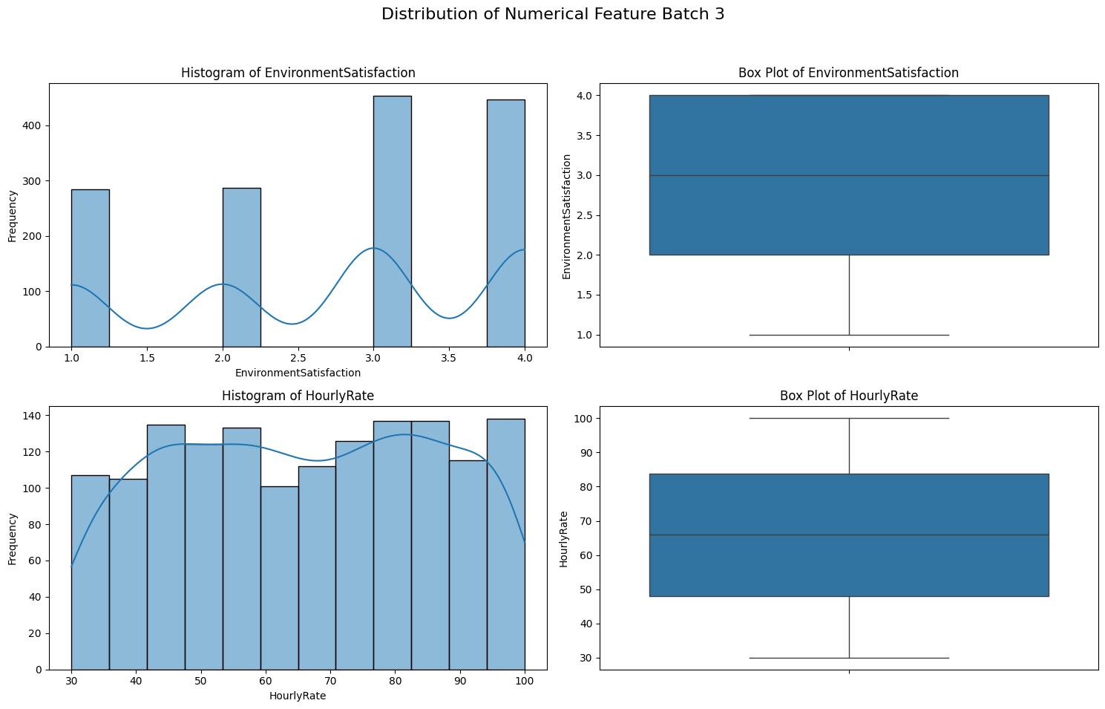

Slide 18
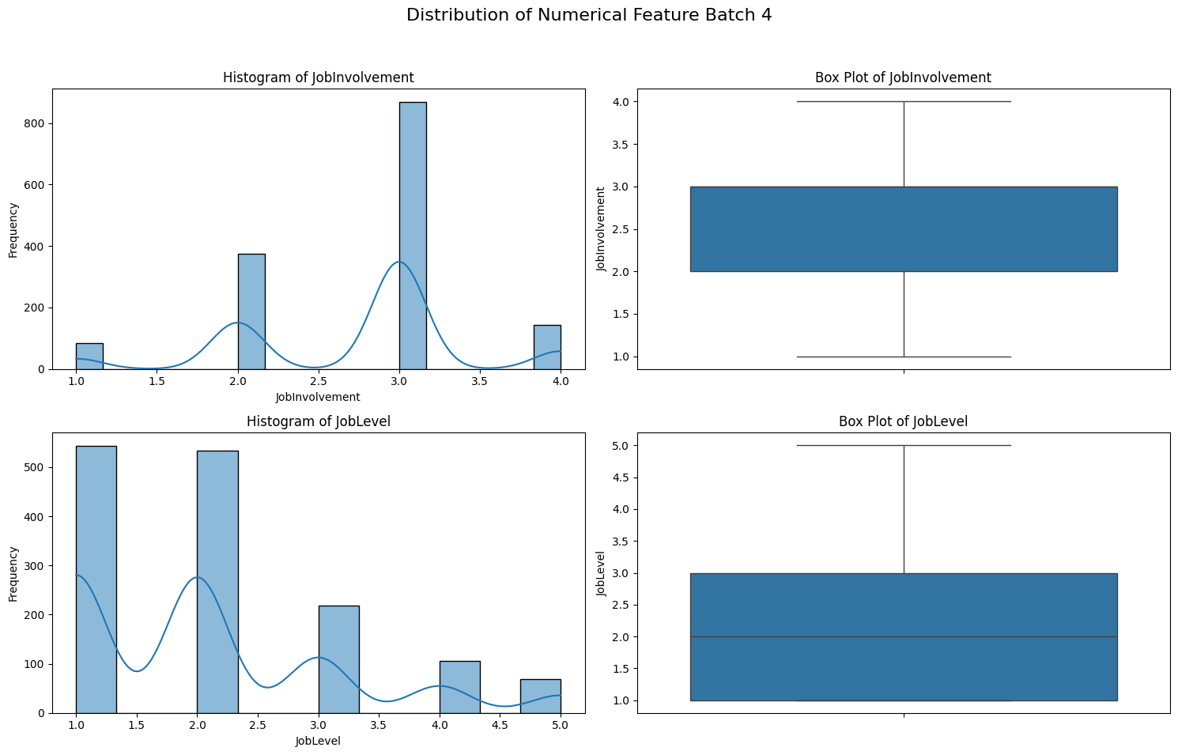

Slide 19
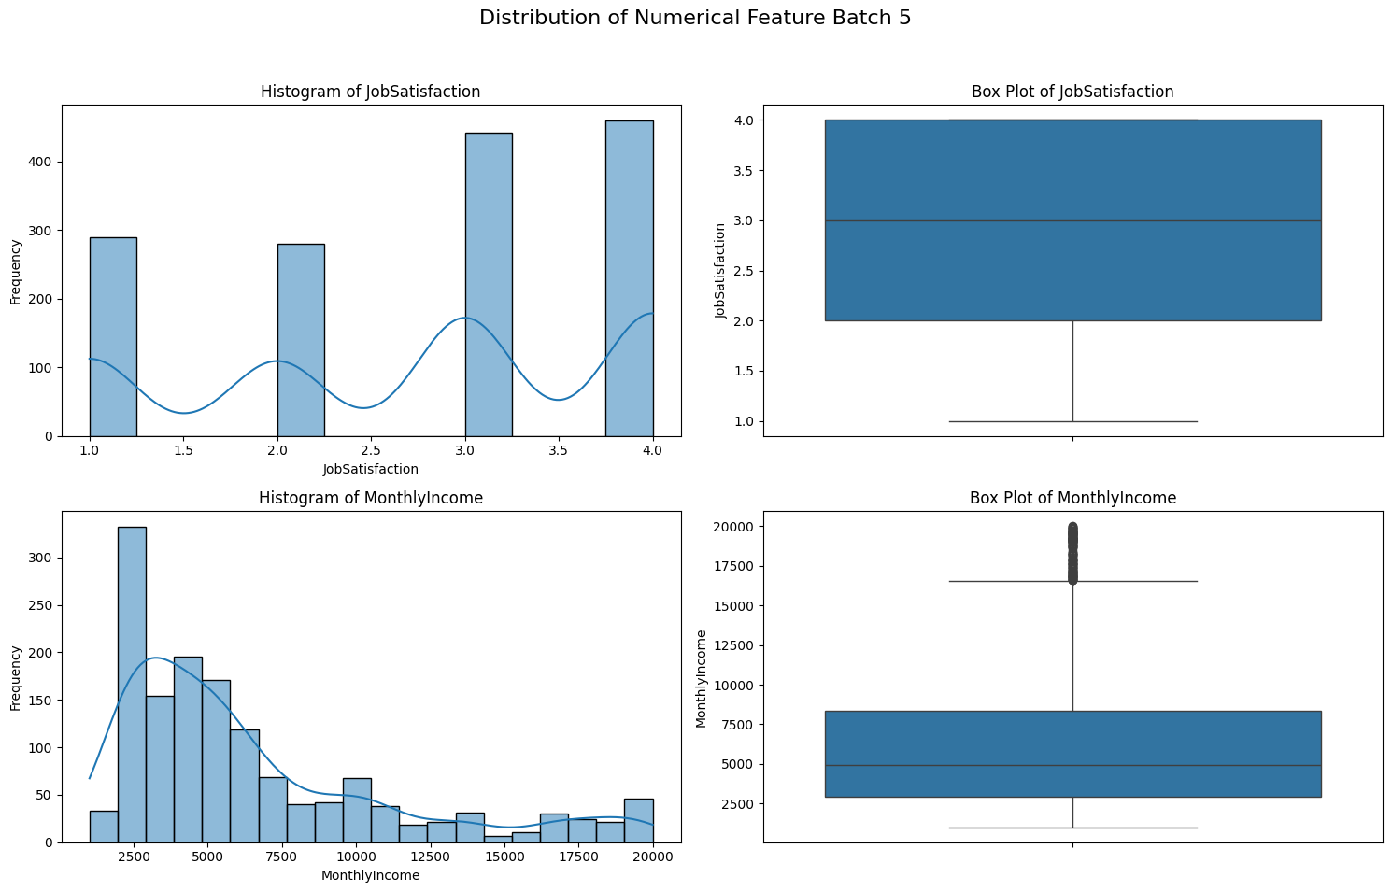

Slide 20
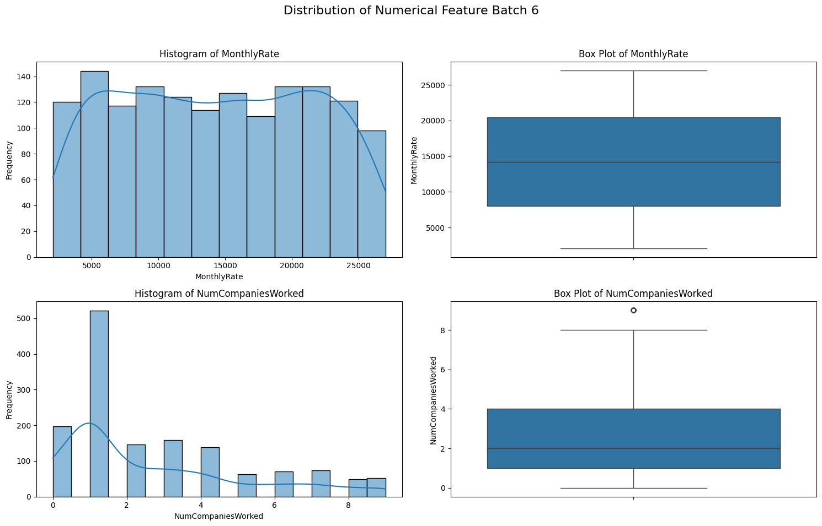

Slide 21
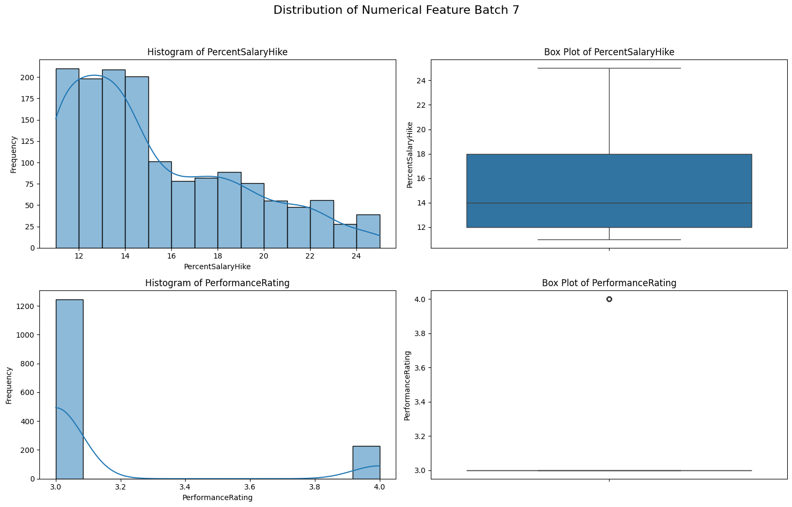

Slide 22
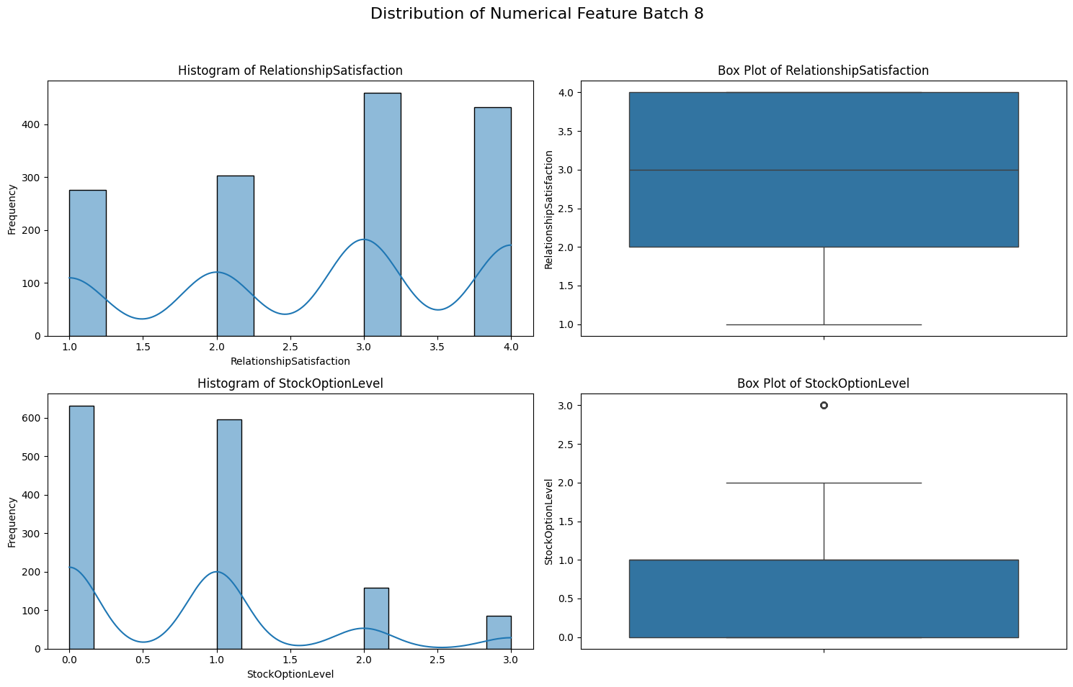

Slide 23
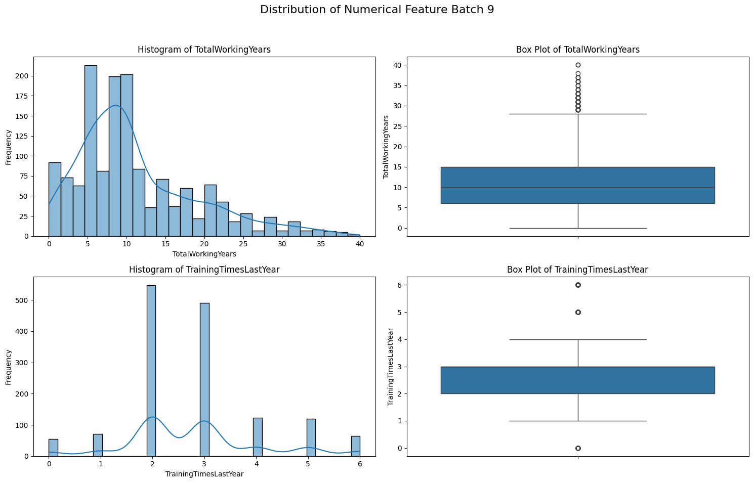

Slide 24
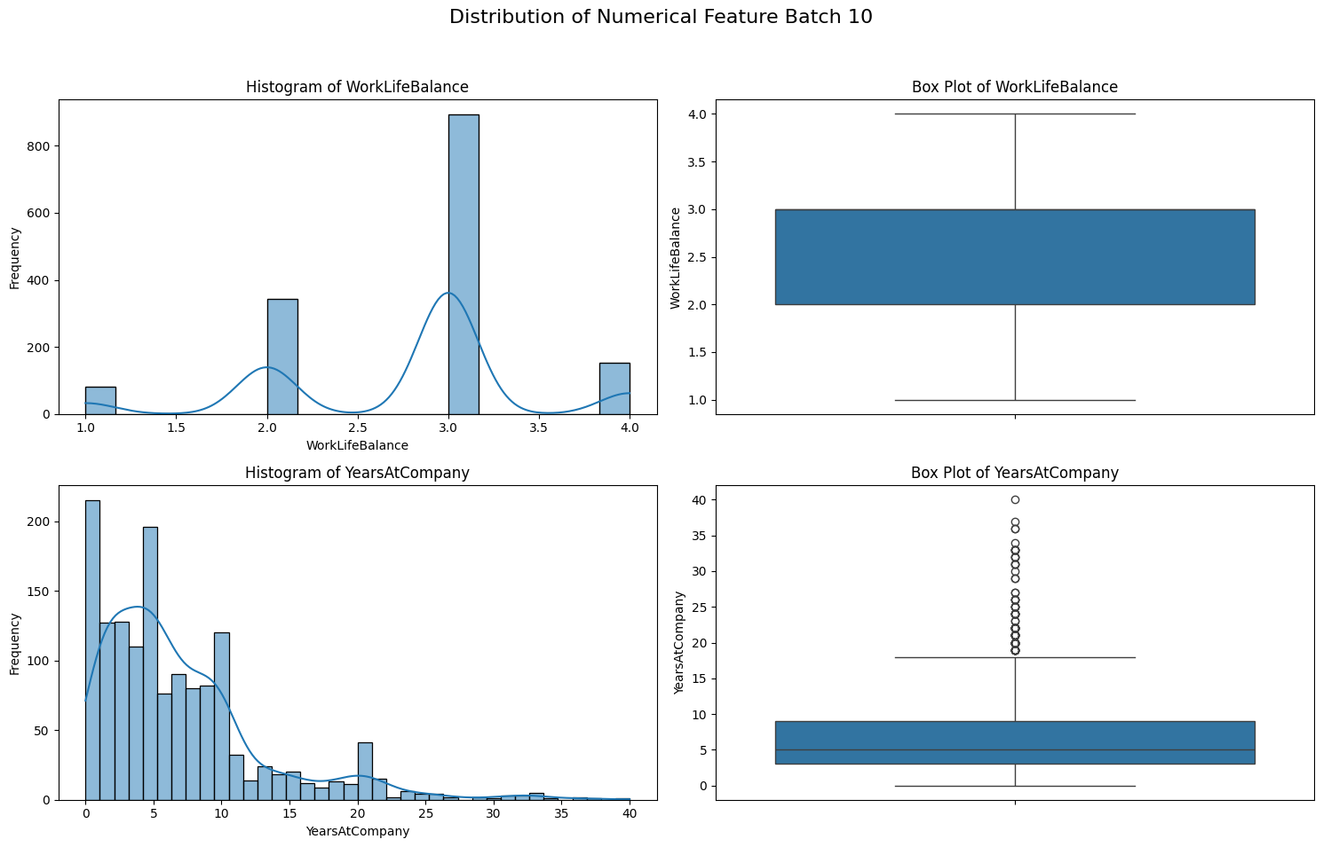

Slide 25
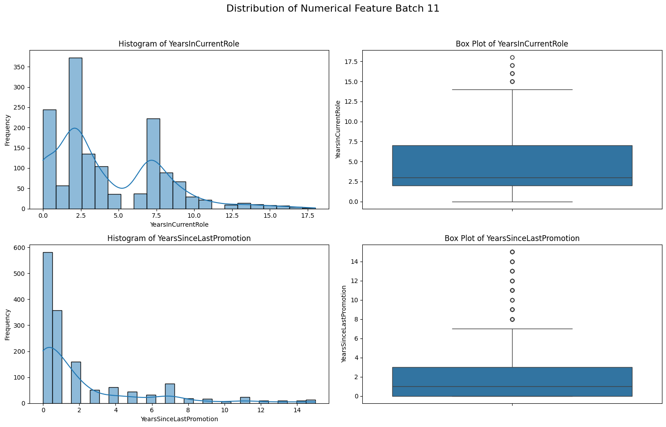

Slide 26
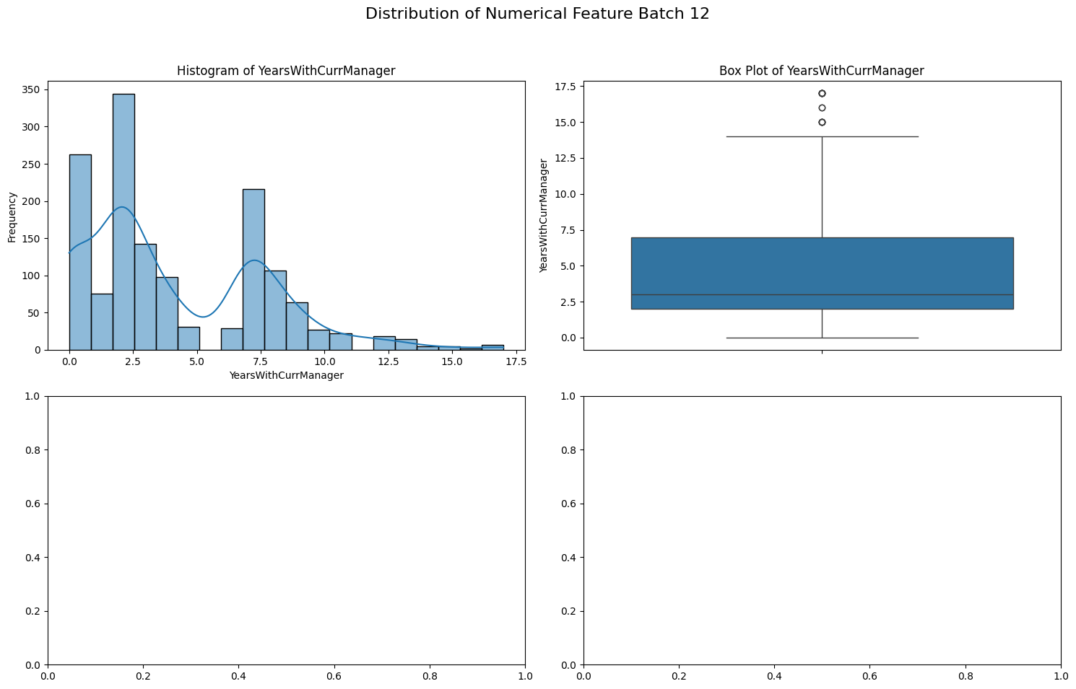

Slide 27
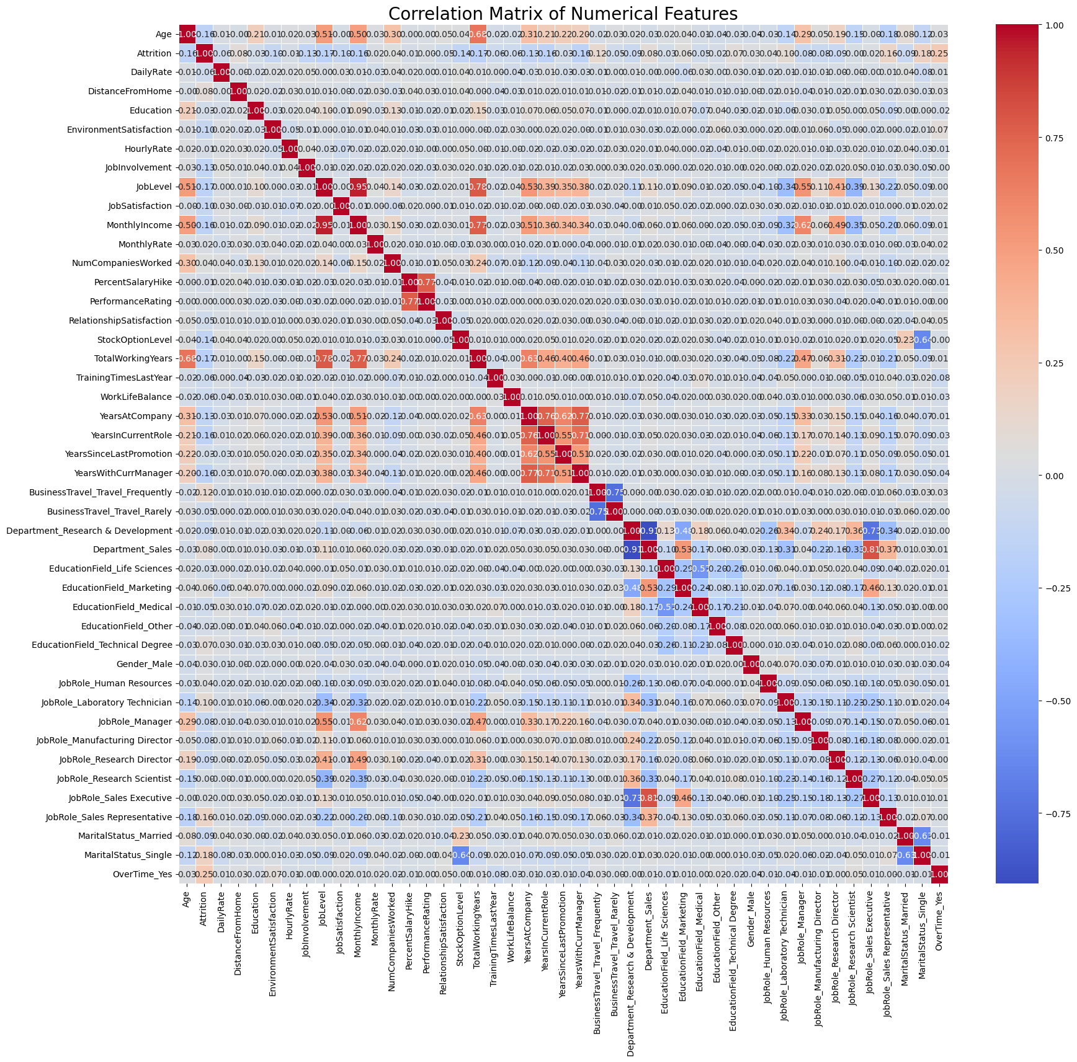

Slide 28
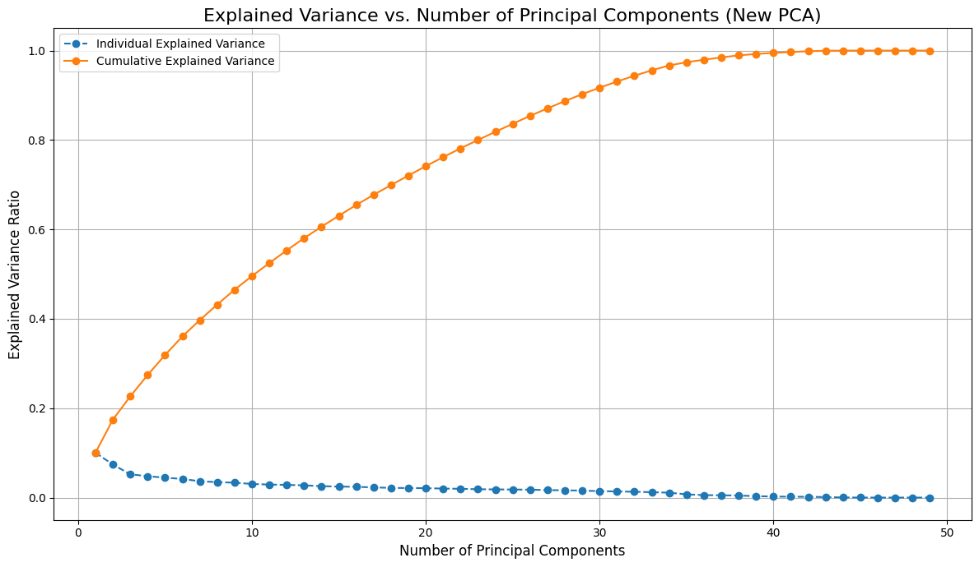

Slide 29
Logistic Regression model :
Model Performance:
Accuracy: 0.8476
Precision: 0.5000
Recall: 0.4688
F1-Score: 0.4839
AUC-ROC: 0.7726
Beginning Decision Tree Classifier
Decision Tree Classifier -
Decision Tree Model Performance:
Accuracy: 0.7810
Precision: 0.3250
Recall: 0.4062
F1-Score: 0.3611
AUC-ROC: 0.6273
Beginning Random Forest Classifier
Random Forest Classifier
Random Forest Model Performance:
Accuracy: 0.8524
Precision: 0.6000
Recall: 0.0938
F1-Score: 0.1622
AUC-ROC: 0.6676

Slide 30
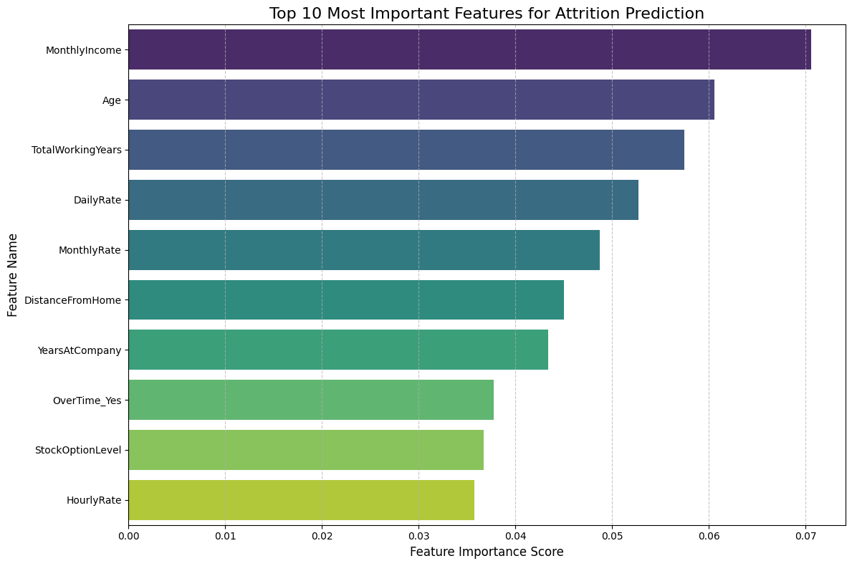

Slide 31
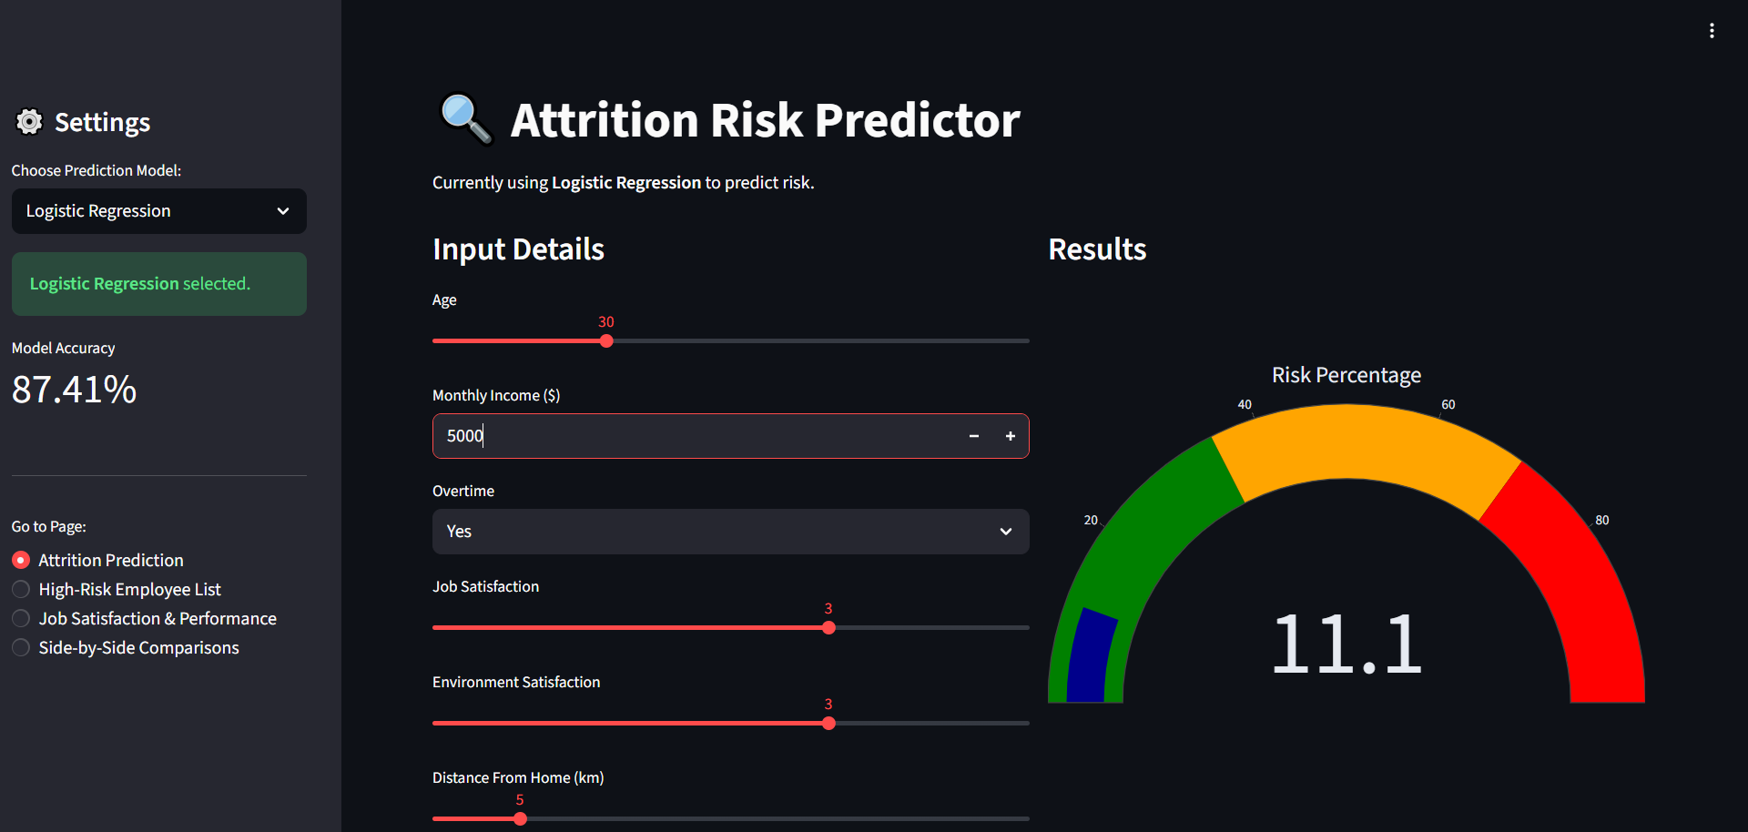

Slide 32


